Slide 1

PROGRAMS AND PROJECTS OF THE DEPARTMENT OF AGRICULTURE ON SUSTAINABLE WATER MANAGEMENT
TERESITA S. SANDOVAL
Chief, Water Resources Management Division
Bureau of Soils and Water Management
Presented during the Negros Water Summit held at Negros First Hostel, Bacolod City on February 27-28, 2020
Notes:
Good morning to everyone, the Bureau of Soils and Water Management would like to thank the organizer for inviting us to this important forum. Our Director, Angel C. Enriquez was not able to be with us this morning because of equally important commitment, on her behalf, I will be presenting to you the topic “Water Technologies for Sustainable Agriculture”.
Responding to climate change while addressing food security problem requires strategic measures in the agriculture sector by way of pursuing a sustainable agriculture that takes into account our concern to increase agricultural production without comprising the sustainability of vital ecosystem, which is the main content of our presentation.

Slide 2

INTRODUCTION
Notes:
Despite net food imports, the agriculture and fisheries sector is still the main source of food and livelihood. However, the sector is very sensitive to both biophysical and economic challenges.

Slide 3

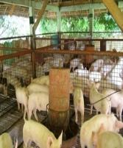
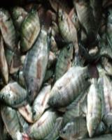
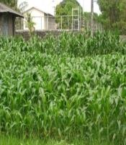
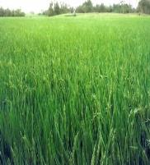
Agriculture is the highest consumption of water among sectors ( 70 %)
Rice production is our main farming activity
In one season, a square meter paddy rice field is applied with about 2,000 li water
We need about 4,000li water to produce 1 kg of rice
Agriculture is also a polluter of both surface and groundwater
Notes:
Despite net food imports, the agriculture and fisheries sector is still the main source of food and livelihood. However, the sector is very sensitive to both biophysical and economic challenges.

Slide 4

Water Resource Management
development of water bodies for intended specific use (e.g. irrigation) or multiples uses (e.g. multi-functions dams)
protection of available water bodies from pollution and degradation to prevent conflicts or disputes. Our water bodies has classification with corresponding standard quality.
Notes:
Despite net food imports, the agriculture and fisheries sector is still the main source of food and livelihood. However, the sector is very sensitive to both biophysical and economic challenges.

Slide 5
Agriculture Water Management
Efficient and appropriate development and use of water for improving crop productivity (i.e. thru irrigation)
Need to understand crop water requirement, irrigation system requirements, means to reduce unproductive water losses and prevent land and water degradation
Notes:
Despite net food imports, the agriculture and fisheries sector is still the main source of food and livelihood. However, the sector is very sensitive to both biophysical and economic challenges.

Slide 6

SUSTAINABLE WATER MANAGEMENT FRAMEWORK
LANDSCAPE
COASTAL PLAIN
ALLUVIAL PLAIN
UPLAND
HILLY TO MOUNTAINOUS
COASTAL AQUIFERS; SALTWATER INTRUSION
RUNOFF DEPOSITION; SHALLOW AQUIFERS; RECHARGE AREA; WATER CONTAMINATION; IRRIGATION; DRAINAGE & FLOODING SILTATION; RETURN FLOWS FROM IRRIGATION
RUNOFF & REPLENISHMENT ZONE; DEEP WELL AREA; SPRINGS
RUNOFF & REPLENISHMENT ZONE; DFFICULT AREA, HEADWATERS ZONE
WATER REGIME
MORE REGULATED INSTALLA-TION OF STW
ON-FARM WATER SAVING & CONSERVATION; ON-FARM WATER STORAGE (SFR); INSTALLATION OF STW, PISOS, PIS, & CONSTRUCTION OF DD; UTILIZATION OF RETURN FLOWS THROUGH DIVERSION , WATER DISTRIBUTION STRATEGIES
RAINWATER HARVESTING (e.g. SWIP & SFR); SPRING DEVELOPMENT; SOIL MOISTURE CONSERVATION; RUNOFF CONTROL
RUNOFF CONTROL;; PROTECTED AREA;
WATER MGMT STRATEGIES
SEA
RICE, CORN, VEGETABLES, & OTHER AGRICULTURAL CROPS,
TERRACED PADDY RICE, HIGH VALUE CROPS, AGRO-FORESTRY CASH CROPS
PROTECTION FOREST. , GRASSLAND
LAND USE
INTEGRATED WATER MANAGEMENT IN A BASIN

Slide 7
Identified Issues and
Concerns on
Water Security in Negros
Occidental Related to Agriculture
and Recommended Actions
Notes:
Despite net food imports, the agriculture and fisheries sector is still the main source of food and livelihood. However, the sector is very sensitive to both biophysical and economic challenges.

Slide 8
Issues and concerns, proposed solutions by stakeholders and DA programs and projects
Issues and concerns related to agriculture | Proposed Solutions (Pre-water summit meeting | DA’s current and future programs and projects to address the concerns
Growing demand for agricultural use in the long term Decreasing supply and changing rainfall pattern and occurrences | Construct impounding dams/reservoirs to provide water for irrigation | Priority program of the DA thru BSWM and DA-RFOs is the implementation of Rainwater Harvesting Facilities such as Small Water Impounding Projects (SWIPs) and Small Farm Reservoir and other Small-scale Irrigation Projects (SSIPs). These facilities harvest rainfall during wet season for use during the dry season. Implementation of DA-AO no. 26 Series of 2007 (Safe reuse of wastewater for irrigation, fertilization and fisheries. Treated wastewater from industries (e.g. sugar mills and distilleries) may be used to augment available freshwater supply but certification from the DA is a requirement. There are several industries in Negros Occidental with certification from the DA tor reuse their wastewater.
Notes:
Despite net food imports, the agriculture and fisheries sector is still the main source of food and livelihood. However, the sector is very sensitive to both biophysical and economic challenges.

Slide 9

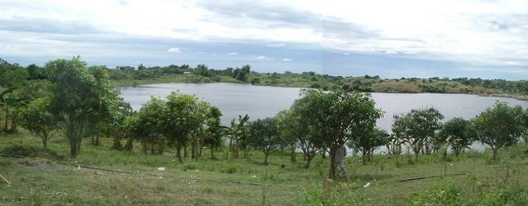

rainwater harvesting (upper watershed)
Rainwater and runoff management thru small water impounding projects (SWIP) for supplemental irrigation, livestock watering, and domestic purposes, groundwater recharge, and flood mitigation……….
Community-managed Small Water Impounding Project, Maasin SWIP, Talugtog, Nueva Ecija
Notes:
Rainwater and run off management thru SWIP is identified as one climate change adaptation strategies.

Slide 10
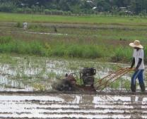
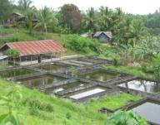
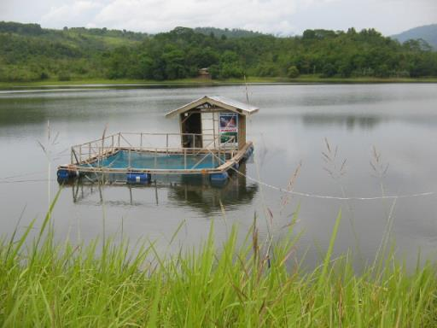
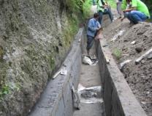
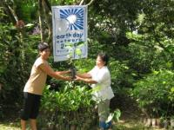
The Success of Libasan Small Water Impounding Project, Nabunturan, ComVal
Fish Hatchery and Inland Fishery
Crop Production
STRONG PARTNERSHIP AND STRONG FARMING COMMUNITIES
Strong Farmers Participation
Seedlings Dispersal for Watershed Management
Strong Farmers Association – Libasan Multi-purpose Cooperative
Strong LGU support and assistance and linkages with national agencies as they adopt cost-sharing scheme
Continuous upgrading skills of farmers (Capacity Building)
Source: Mr. Belarde Ibe, Chairman LPMPC, 2010
Notes:
The Libasan Small Water Impounding Project is a success story on community managed small water impounding system. The Libasan multi-purpose cooperative which is a recipient of a SWIP in Mindanao is successful in managing a small water impounding project thru strong partnership and strong farming community. For that reason the association became more independent and is now managing the system by themselves.

Slide 11
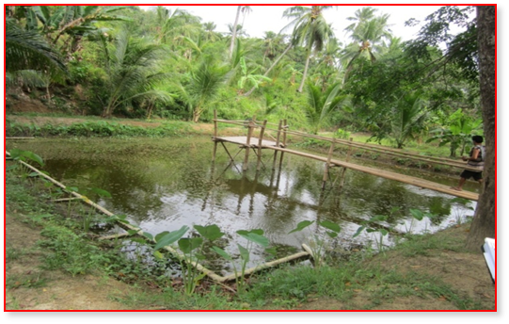
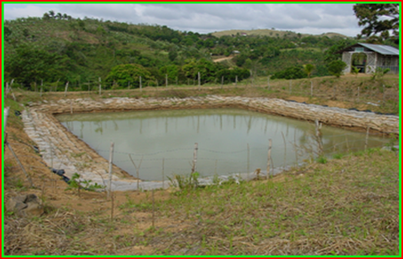
farmer-managed small farm reservoirs (SFR)
SFR constructed by farmers in Mindanao , Philippines
SFR constructed by farmers in Luzon , Philippines
Notes:
Similar to SWIP, small farm reservoir (SFR) intends to collect rainfall and run-off for immediate and future agricultural use. It is constructed with in the farmer’s farm for his own use, operation and management.

Slide 12
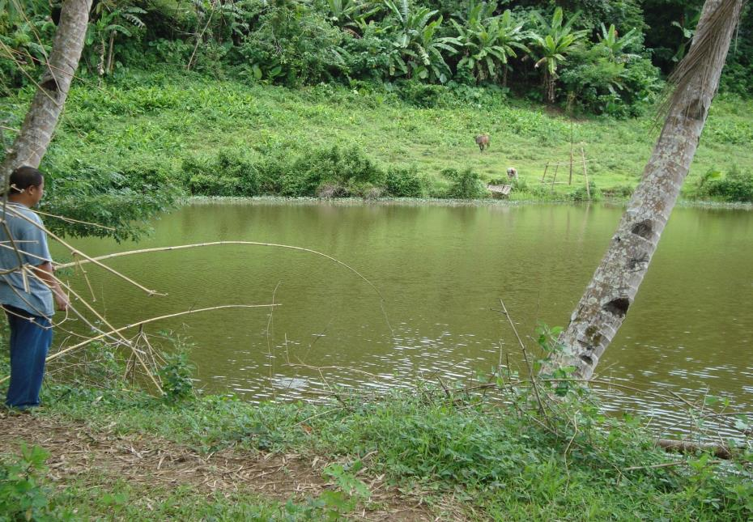
The Success of 125 Small Farm Reservoirs in Bingawan, Iloilo
(Good Governance & Optimization of Limited Resources)
save crop during unexpected prolong drought
promote diversified farming system (e.g. rice and vegetable production, duck raising and inland fish production)
strengthen partnership between and among national agencies, LGUs, CSOs and farmers
Source: Mayor Palabrica’s SFR Presentation, 2016
Notes:
Here is the success story of the establishment of SFRs by the municipality of Bingawan Iloilo. Through good governance and optimization of limited resources with Bingawan being a 4th class municipality they were able to save crops during the peak of El Nino in 2010 and 2015. They were are able to promote diversified farming systems.

Slide 13
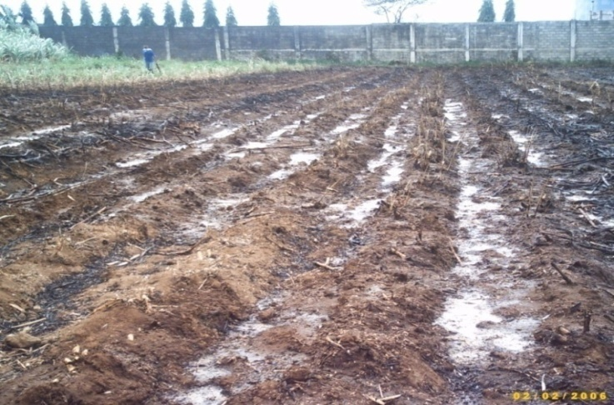
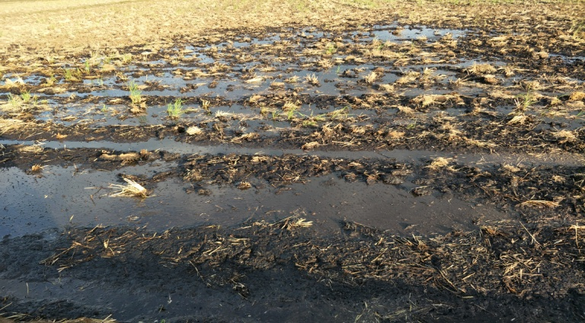
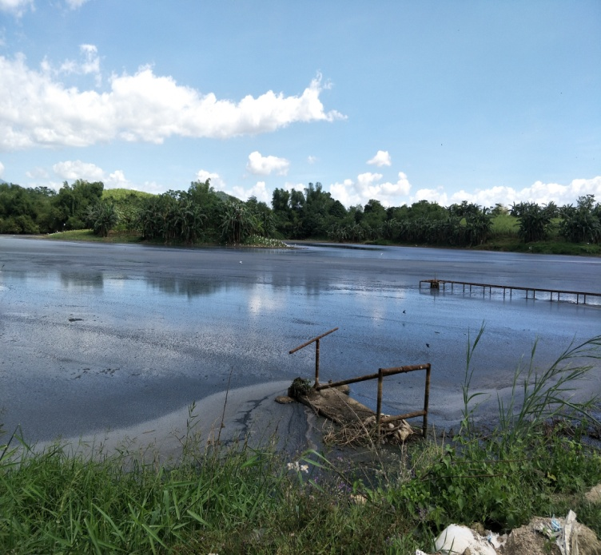
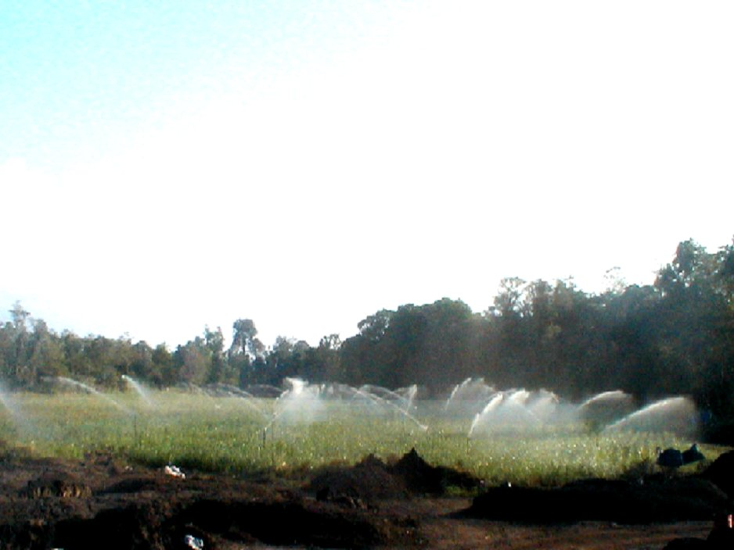
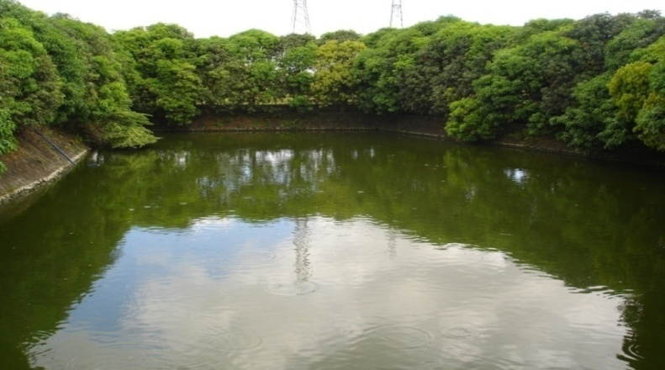
wastewater re-use for agri purposes
Regulated Wastewater Re-use
Use of liquid fertilizer
Use as liquid fertilizer –pre land prep water
Sprinkler irrigation for sugarcane Plantation
Aquaculture (Tilapia Fishpond)
DAO 26, Series of 2007: Guidelines on the Procedures and Technical Requirements for the Issuance of a Certification allowing the Safe Re-use of Wastewater for the Purpose of Irrigation and other Agricultural Uses
Notes:
The Department of Agriculture also encourages the re-use of wastewater by issuing guidelines on the procedures and technical requirements for the safe re-use of wastewater for the purpose of irrigation and other agricultural uses.

Slide 14
Issues and concerns, proposed solutions by stakeholders and DA programs and projects
Issues and concerns related to agriculture | Proposed Solutions (Pre-water summit meeting | DA’s current and future programs and projects to address the concerns
Growing demand for agricultural use in the long term Decreasing supply and changing rainfall pattern and occurrences | Construct impounding dams/reservoirs to provide water for irrigation | One of the strategies of the DA to save water in irrigation is to engage in crop diversification wherein high value crops will be identified in the area and other support systems will be integrated such as marketing. These high value crops require less water and may provide better incomes to farmers. There are also available water-saving technologies or practices such as alternate wetting and drying (AWD) for rice production. About 30% of water is being saved with no significant effect on yield.
Notes:
Despite net food imports, the agriculture and fisheries sector is still the main source of food and livelihood. However, the sector is very sensitive to both biophysical and economic challenges.

Slide 15
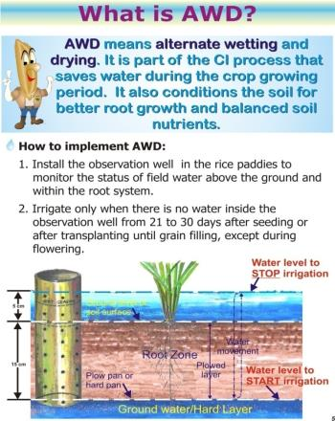
water-saving technologies (e.g. AWD)
  Based on experiments on the soil water threshold that the rice crop can withstand,
  Water level can be allowed to drop below ground surface
    15cm – Dry Season
    20cm – Wet Season
  Generate about 15% - 30% water savings compared to continuous flooding method
DAO 25, Series of 2009: Guidelines for the adoption of Water-saving technologies (WST) in irrigated Rice Production Systems in the Philippines
Source: PhilRice
Notes:
This water saving technology is based on experiments on the soil water threshold that the rice crop can withstand. Water level can be allowed to drop 15 to 20 centimeters below ground surface depending on the cropping season. It can generate about 15%-30% water savings compared to continuous flooding method.

Slide 16
Issues and concerns, proposed solutions by stakeholders and DA programs and projects
Issues and concerns related to agriculture | Proposed Solutions (Pre-water summit meeting | DA’s current and future programs and projects to address the concerns
Inadequate water (transmission) infrastructure for irrigation | Increase investment in water infrastructure through public-private partnership | This year, the DA allocates 250Million pesos for Rainwater Harvesting facilities/Small Irrigation systems to increase investment in irrigation infrastructure. The DA exerts efforts in involving other funding institutions in the implementation of SWIPs and other SSIPs, To date, the DA has approved projects with Israel government thru a loan for Solar-Powered Irrigation System (SPIS) in the amount of 44 Billion pesos for 6,200 SPIS nationwide. Feasible sites for this is being done by the concerned DA-RFOs. The PPP scheme may not be attractive to SSIPs but rather to multi-functions dams (with hydropower and domestic use components) for the recouping of their investments
Notes:
Despite net food imports, the agriculture and fisheries sector is still the main source of food and livelihood. However, the sector is very sensitive to both biophysical and economic challenges.

Slide 17
Issues and concerns, proposed solutions by stakeholders and DA programs and projects
Issues and concerns related to agriculture | Proposed Solutions (Pre-water summit meeting | DA’s current and future programs and projects to address the concerns
Depletion of freshwater sources low groundwater recharge/percolation rate Excessive groundwater withdrawal that leads also to saline intrusion | Utilize alternative water sources through Desalination Rainwater harvesting Storm water management | Management or regulation of groundwater withdrawal /pumping . There is national policy on sustainable groundwater extraction local regulation is more important. Prioritize the development of shallow groundwater thru Shallow Tubewell Irrigation Project and other pump irrigation system such as solar and wind pumps Rainwater Harvesting and run-off management projects such as SWIPs and SFRs are being undertaken by DA. These projects recharge our aquifers. Also our paddy rice fields are GW rechargers. Improvement of soil physical structure thru sub soiling and organic application esp in sugarcane areas .
Notes:
Despite net food imports, the agriculture and fisheries sector is still the main source of food and livelihood. However, the sector is very sensitive to both biophysical and economic challenges.

Slide 18
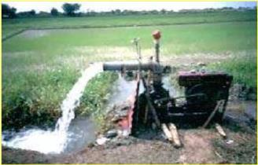
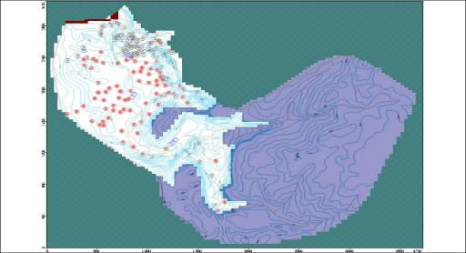
water supply augmentation thru regulated STW installation
Inventory and mapping of STWs within a basin/sub-basin
Determine annual total extraction and recharge
Total groundwater extraction should not exceed recharge (i.e. with sufficient GW discharge at the coast to prevent saline water intrusion in coastal aquifers)
Notes:
Shallow tubewells is appropriate in many areas of the country particularly in alluvial plains, river valleys and coastal areas where shallow well areas are prominent. This is a good source for water supply augmentation but with a more regulated approach of development so that we will not go beyond the sustainable yield of an aquifer. At this stage we need to determine the current extraction and the available groundwater supply. This is a big challenge for us but we need to ensure that our groundwater extraction should not exceed groundwater recharge to avoid over-exploitation of the resource and the corresponding environmental damages.

Slide 19
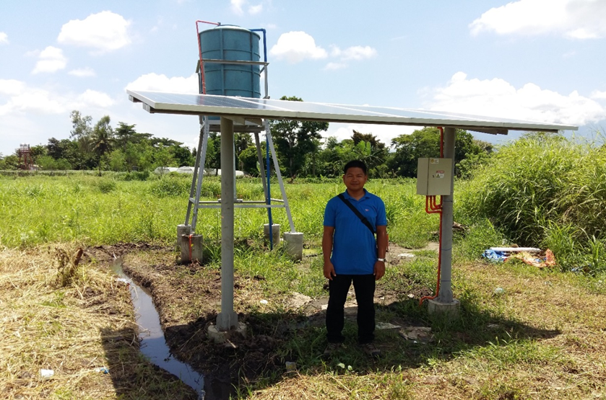
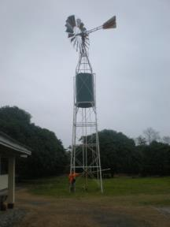
pump irrigation system utilizing both surface and groundwater
Solar pump
Wind pump
Notes:
The Department of Agriculture is also promoting small pump irrigation system for high value crops utilizing renewable energy. With the leadership of Secretary Pinol, the department of Agriculture is now starting to implement Solar Pump Irrigation Projects for rice production.

Slide 20
Issues and concerns, proposed solutions by stakeholders and DA programs and projects
Issues and concerns related to agriculture | Proposed Solutions (Pre-water summit meeting | DA’s current and future programs and projects to address the concerns
El Nino and extreme weather events | Educate consumers on water conservation/water efficiency | DA continue to provide support on Cloud Seeding Operations as immediate response to El Nino or prolong drought periods. Negros Occidental is one of the recipients of this intervention for years. DA encourages farmers to practice water-saving strategies, shifting of cropping calendar, and crop diversification. DA also provides pump sets for STW or Pump irrigation system from open source as immediate intervention.
Notes:
Despite net food imports, the agriculture and fisheries sector is still the main source of food and livelihood. However, the sector is very sensitive to both biophysical and economic challenges.

Slide 21
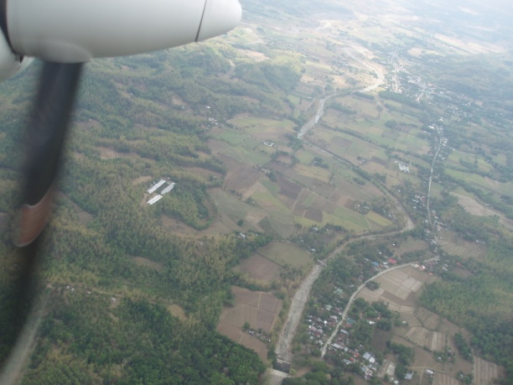
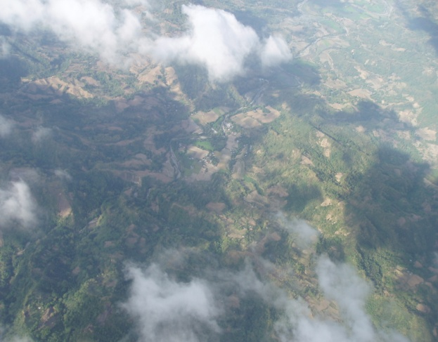
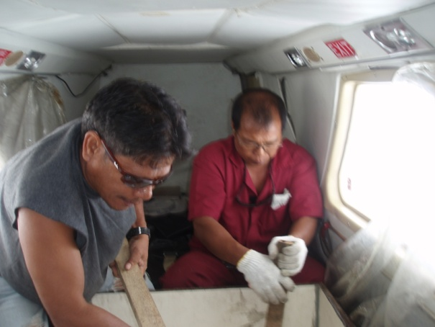
cloud seeding operations
IMMEDIATE RESPONSE to offset the effects of prolonged drought on agricultural areas and watersheds
PER REQUEST FROM CONCERNED GOVERNMENT AND PRIVATE ENTITIES
The success of the cloud depends largely on the presence of seedable clouds and the technical capability of the people undertaking the operation.
Notes:
The Department of Agriculture is also promoting small pump irrigation system for high value crops utilizing renewable energy. With the leadership of Secretary Pinol, the department of Agriculture is now starting to implement Solar Pump Irrigation Projects for rice production.

Slide 22
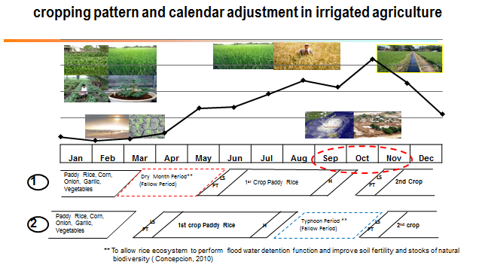
Notes:
With the changing rainfall pattern and extent of damages brought by typhoons and other hydro-meteorological hazards, there is a need to adjust our cropping systems. In one year we have two cropping in irrigated agriculture. Considering that about 70% of our losses is primarily due to typhoon the strongest of which usually occur during months of Sept, Oct and Nov. Adjusting our cropping calendar that will avoid the Typhoon months during the crop reproductive stage or harvest is another option to consider in irrigated agriculture. Fallow period during the rainy season will allow our rice ecosystem to perform flood water detention function and improve soil fertility and stocks of natural biodiversity.

Slide 23
Final Remarks
Water management in the agriculture sector should be examined in the general framework of sustainable development goal that addresses environmental challenges (e.g. climate change), attainment of economic targets, and provision of social needs;
Within the context of a basin, Integrated Water Resource Management (IWRM) plays a critical role in ensuring sustainable agriculture development which “maintains an acceptable and increasing level of productivity while protecting and enhancing the quality of land and water resources to meet future needs”.
Notes:
From our presentation, we can say that:
Water management in the agriculture sector should be examined in the general framework of sustainable development goal that addresses environmental challenges (e.g. climate change, land degradation, bio-diversity decline), attainment of economic targets, and provision of social needs;
Within the context of a basin, IWRM plays a critical role in ensuring sustainable agriculture development which “maintains an acceptable and increasing level of productivity while protecting and enhancing the quality of land and water resources to meet future needs”.

Slide 24
THANK YOU
AND
GOOD DAY!

Slide 25
Department of Agriculture
Bureau of Soils and Water Management
Water Resources Management Division
SRDC Bldg. Elliptical Road corner Visayas Avenue,
Diliman, Quezon City, Philippines
Telephone/Telefax: (02) 923-0454
E-mail Address: waterresources.bswm@gmail.com
www.bswm.da.gov.ph

